Slide 1

Final Demo Back-up PowerPoint
System32

Slide 2



Total Annual Cost
Amelia & Hostinger
179.40 + 89 = $268.40
Turnover Procedure
Provide usernames, passwords, and email access to admin accounts, as well as comprehensive training covering: platform navigation, content management, user management, and site maintenance

Slide 3
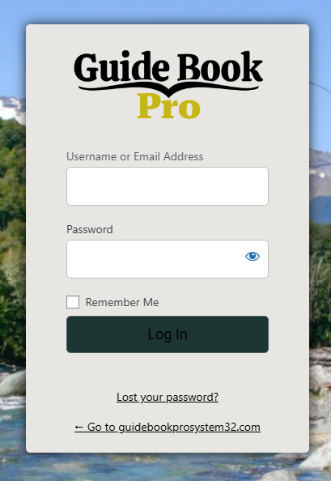
Login Page
This is where registered users will be automatically directed to sign into the site.

Slide 4
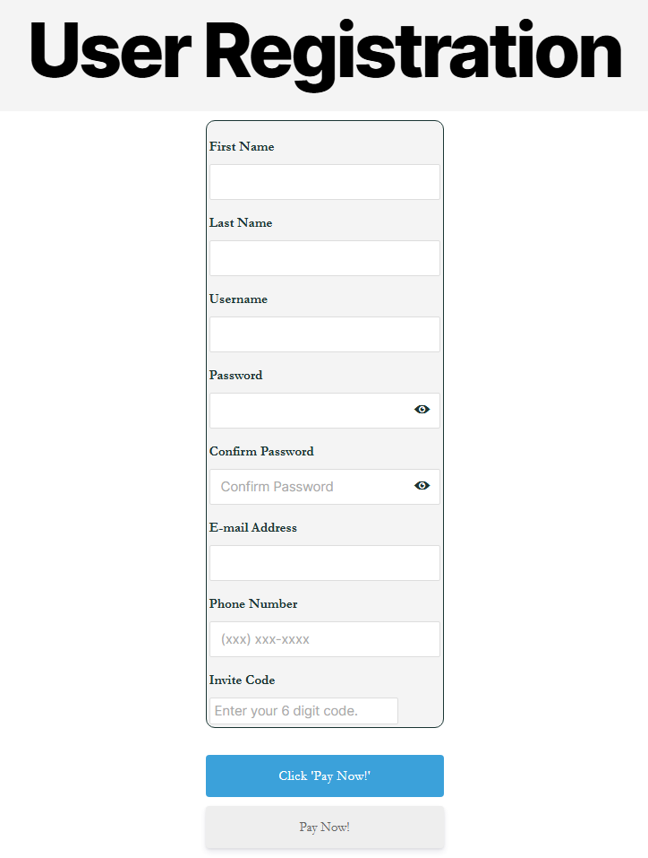
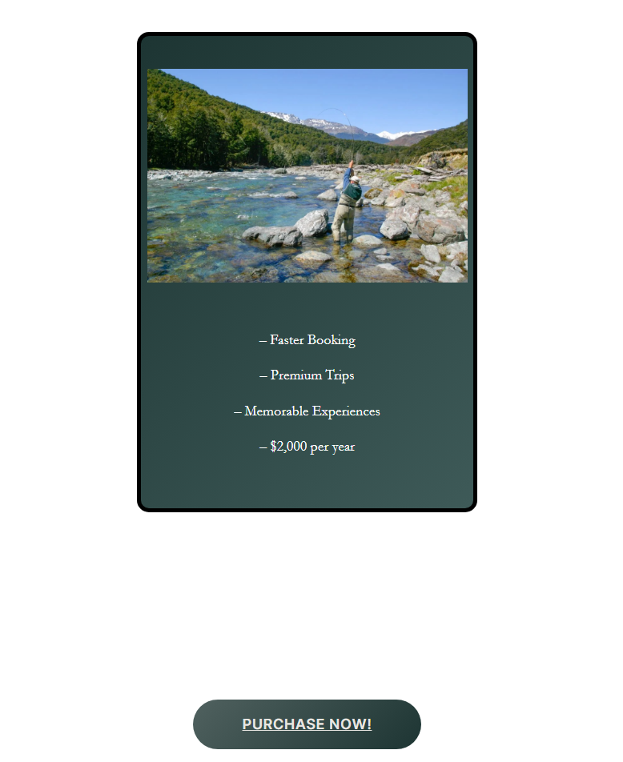
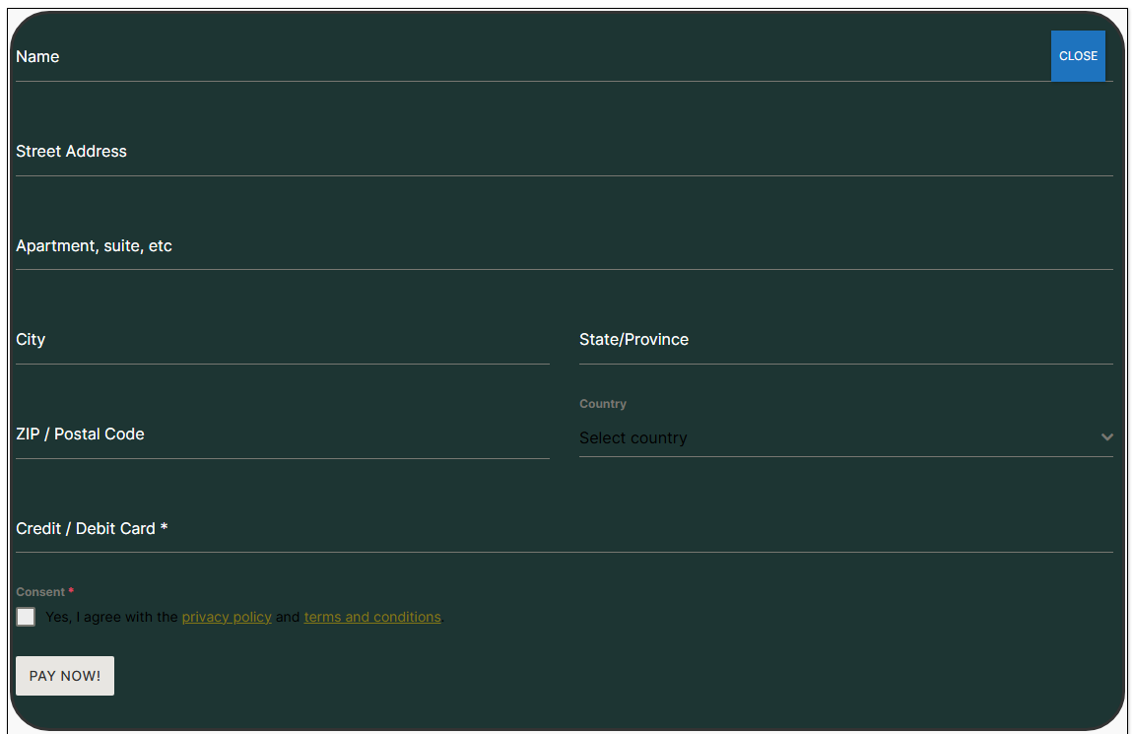
Registration Page
Subscription Page
This is the page where users can register to use the site, regardless of their subscription status.
This is the page and pop-up that appear as users sign up for the paid guidebook pro service.

Slide 5
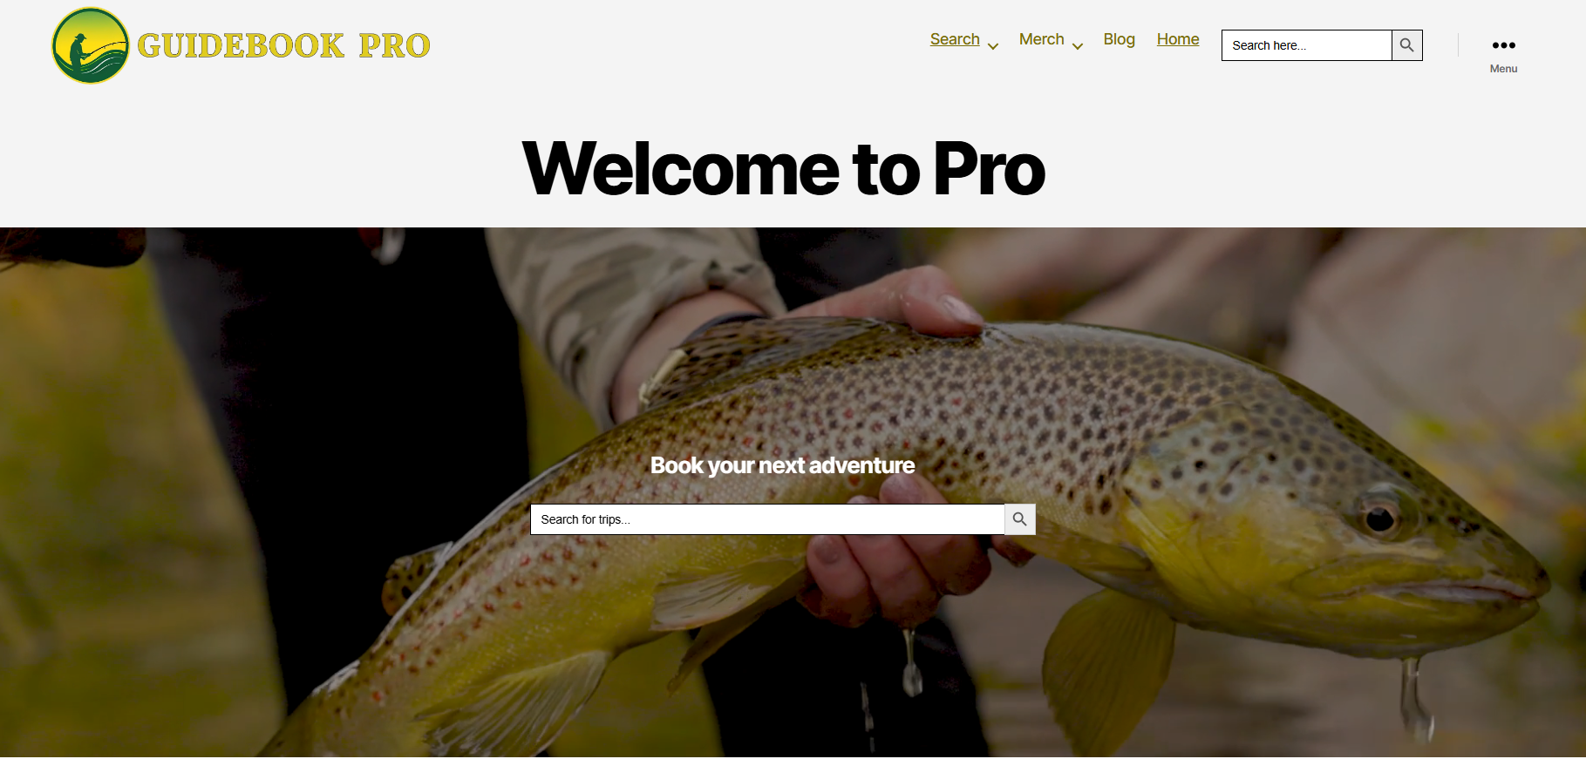
Home Page
This will serve as the main landing page, where users will be able to find info about featured trips, guides, species and more.

Slide 6
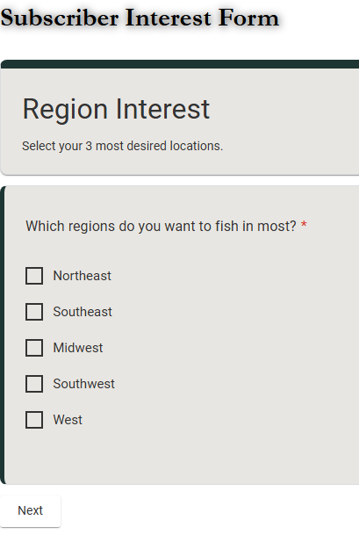
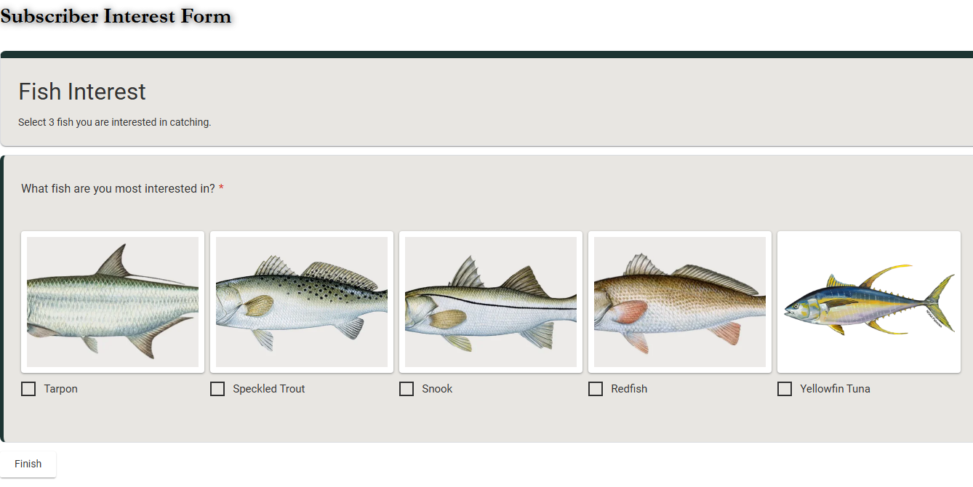
Subscriber Interest Form
This is the initial 2-question survey users see upon subscribing, to help maximize their site experience through their responses.

Slide 7
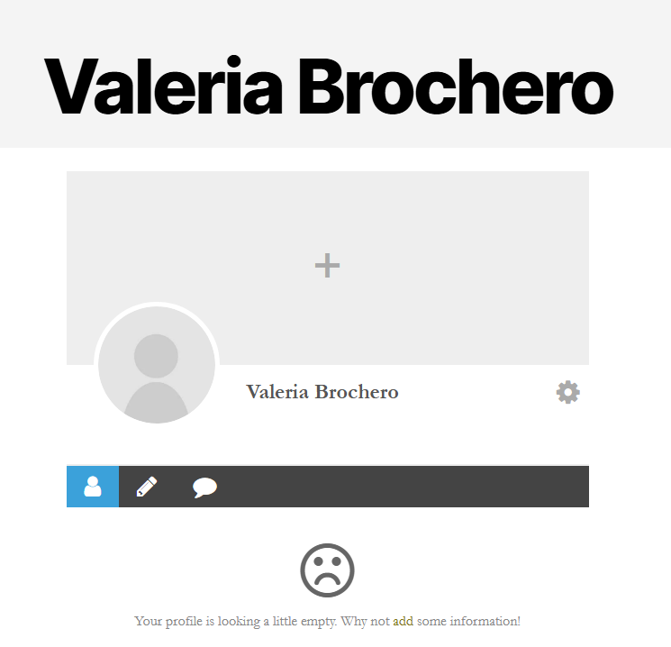
Guide/User Profile Page
This is what an empty profile will look like before it’s filled out by a guide or user.

Slide 8
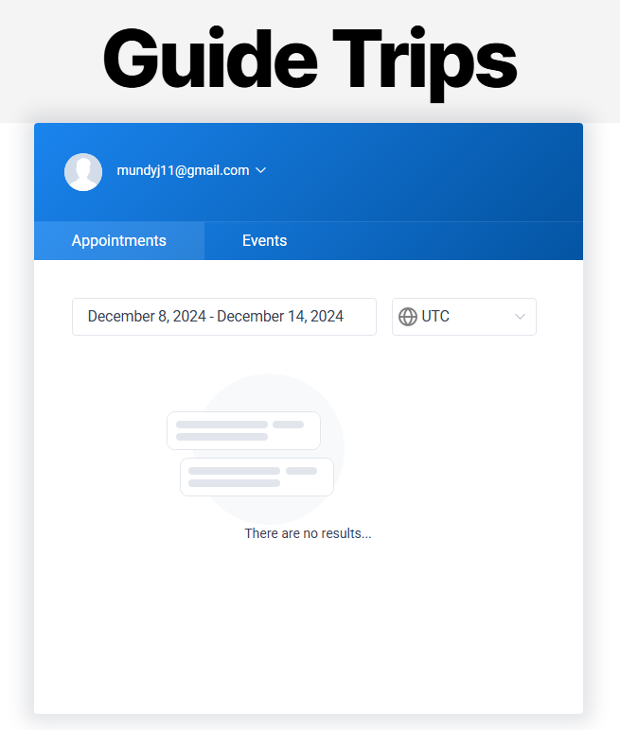
Guide Trips Page
Similarly, this is where a guide would be able to review all their scheduled trips by date.

Slide 9
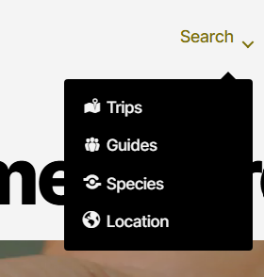
Search Dropdown
By using this feature, users will be able to filter their search to specific topics like trips, guides, species, and location.

Slide 10
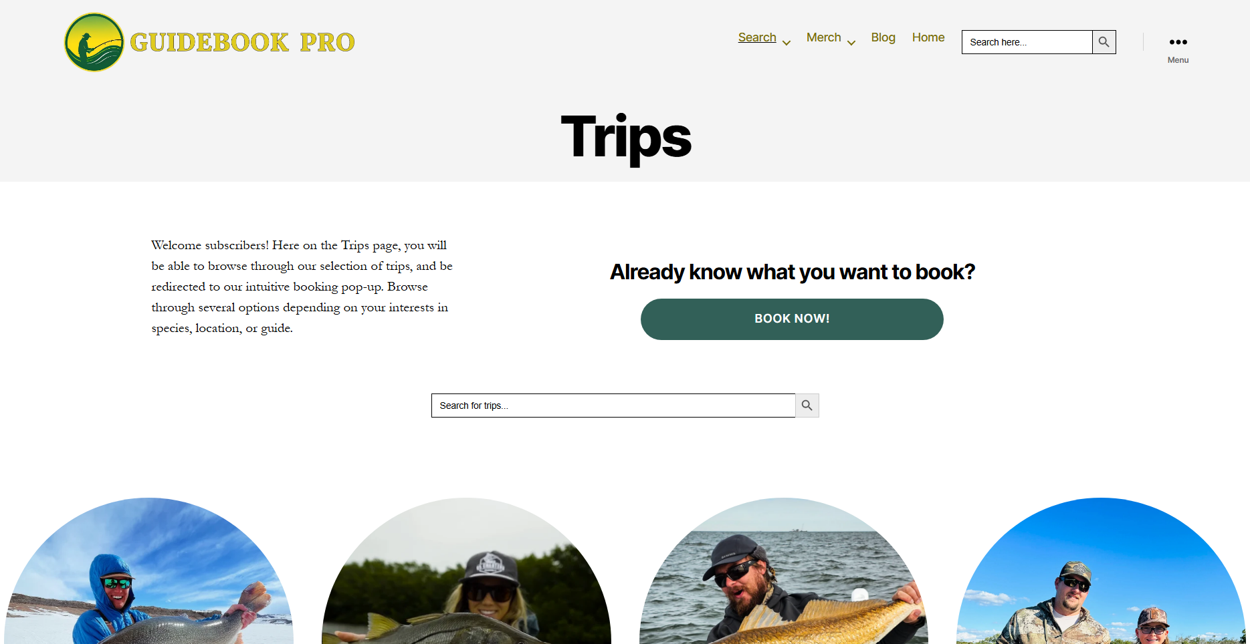
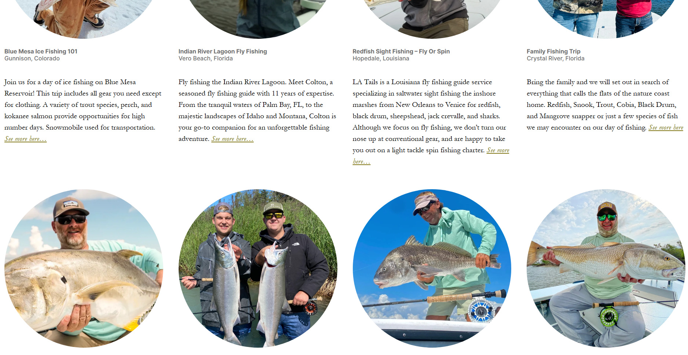
Trips Page
This page allows users to view all trips being offered in the near future and to click into individual trips to learn more about them and book.

Slide 11
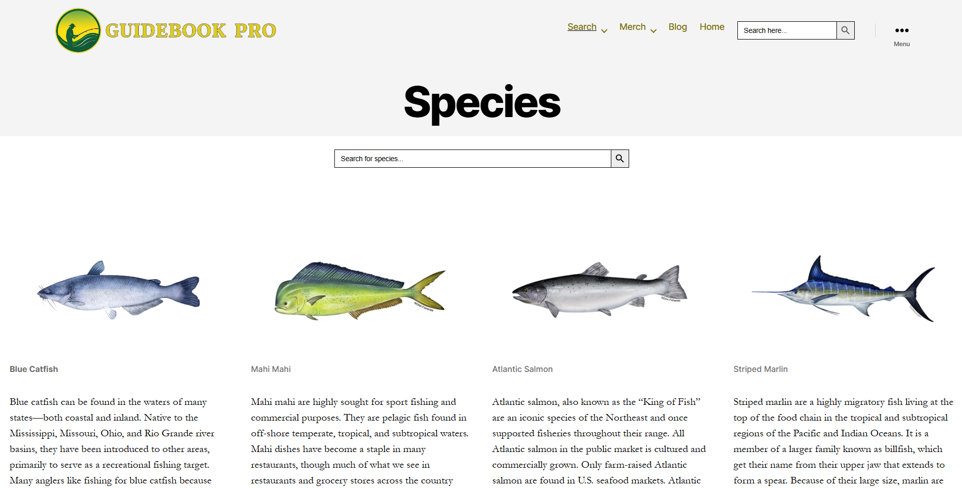
Species Page
This page allows users to search for their preferred fish species and find trips and guides that align with these interests.

Slide 12
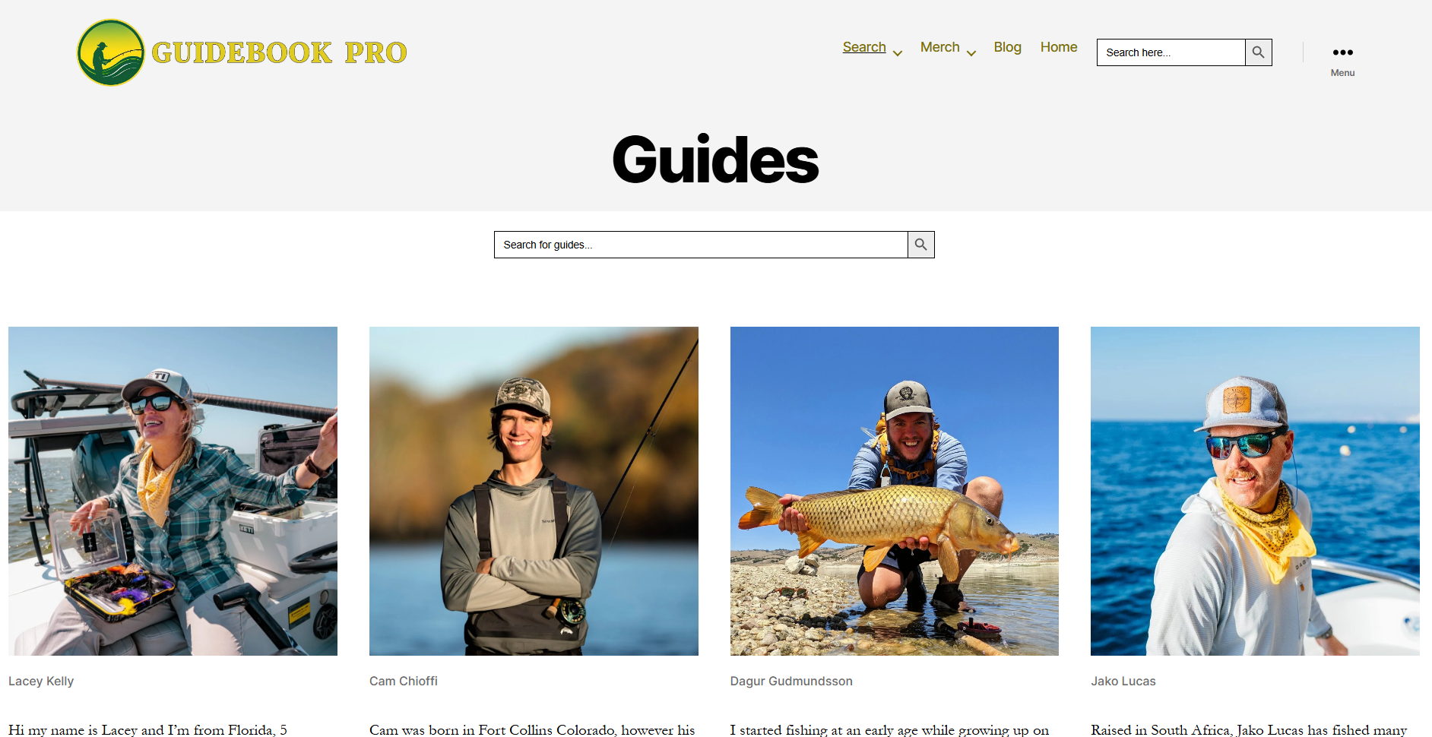
Guides Page
This page allows users to search through Guidebook’s professional guides and find the person best suited to lead their experience depending on the trip.

Slide 13
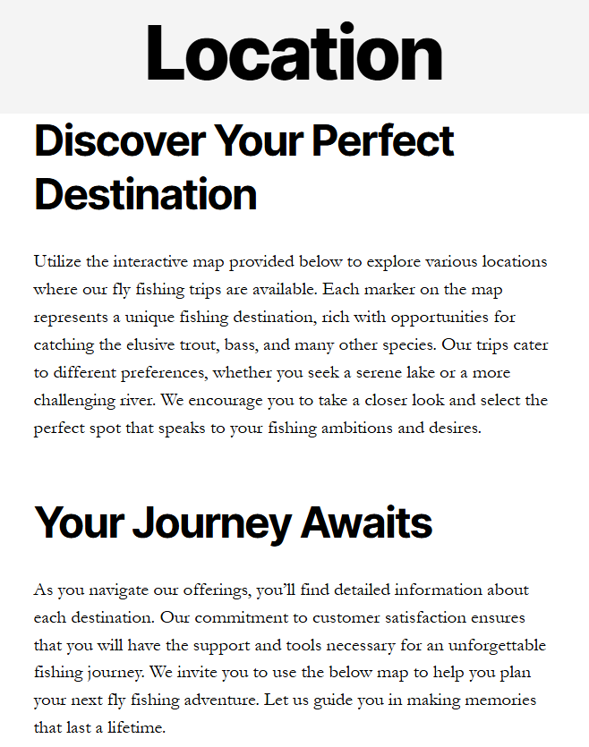
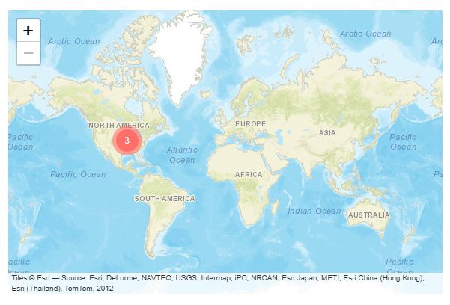
Location Page
This page allows users to visually search an interactive map for trip locations and redirects them to individual trip pages with more information + booking options.

Slide 14
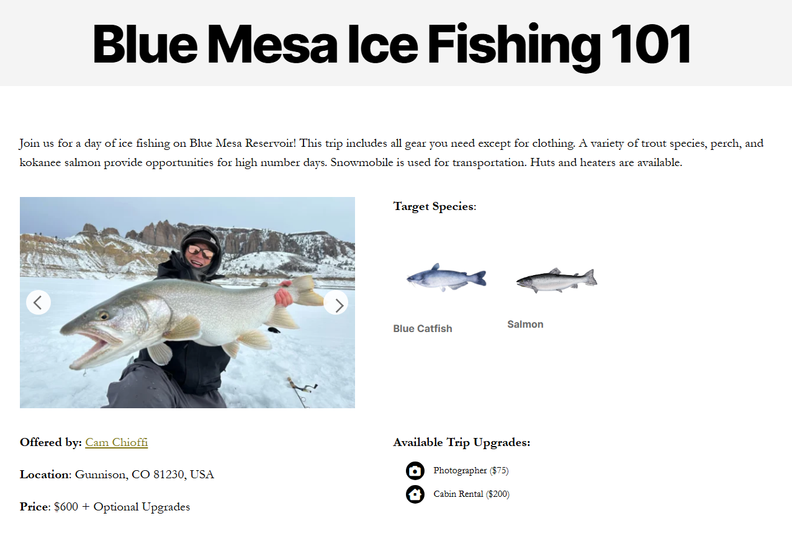
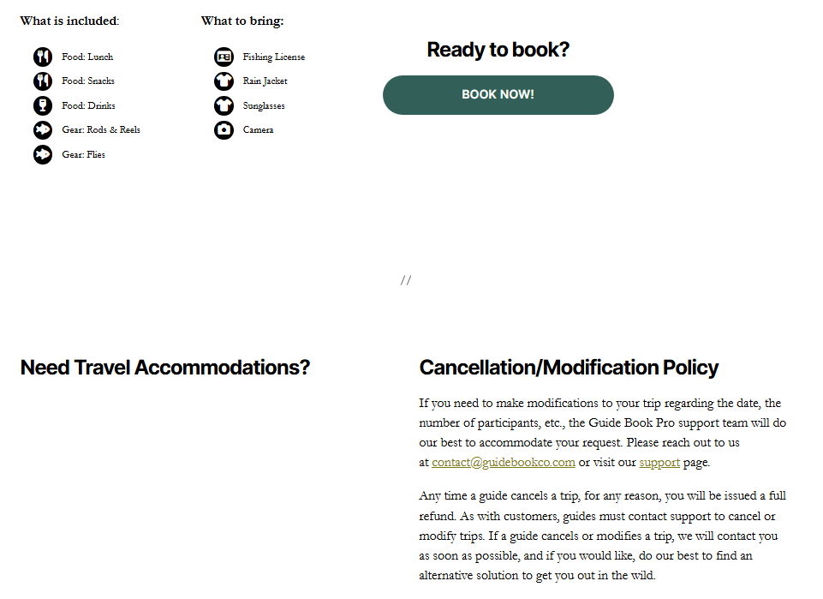
Individual Trip Page
On this page, users can find all important information regarding a trip including cost, location, guide, species available, travel accommodations, and the cancellation policy. There is also the ‘Book Now!’ button to aid in the scheduling process.

Slide 15
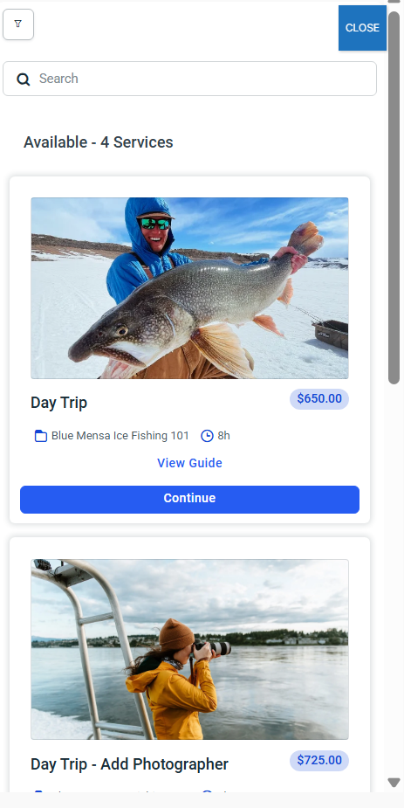
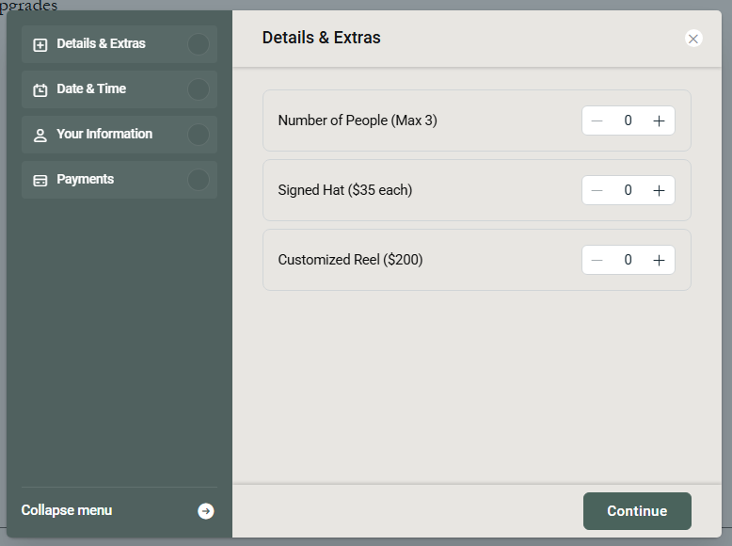
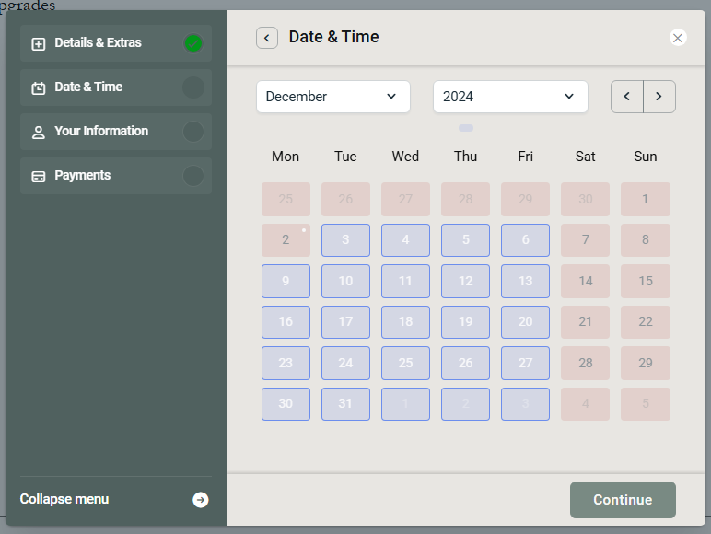
Booking Pop-Up
This is what the booking process will look like for users upon selecting a trip. This pop-up is powered by the Amelia plug-in.

Slide 16
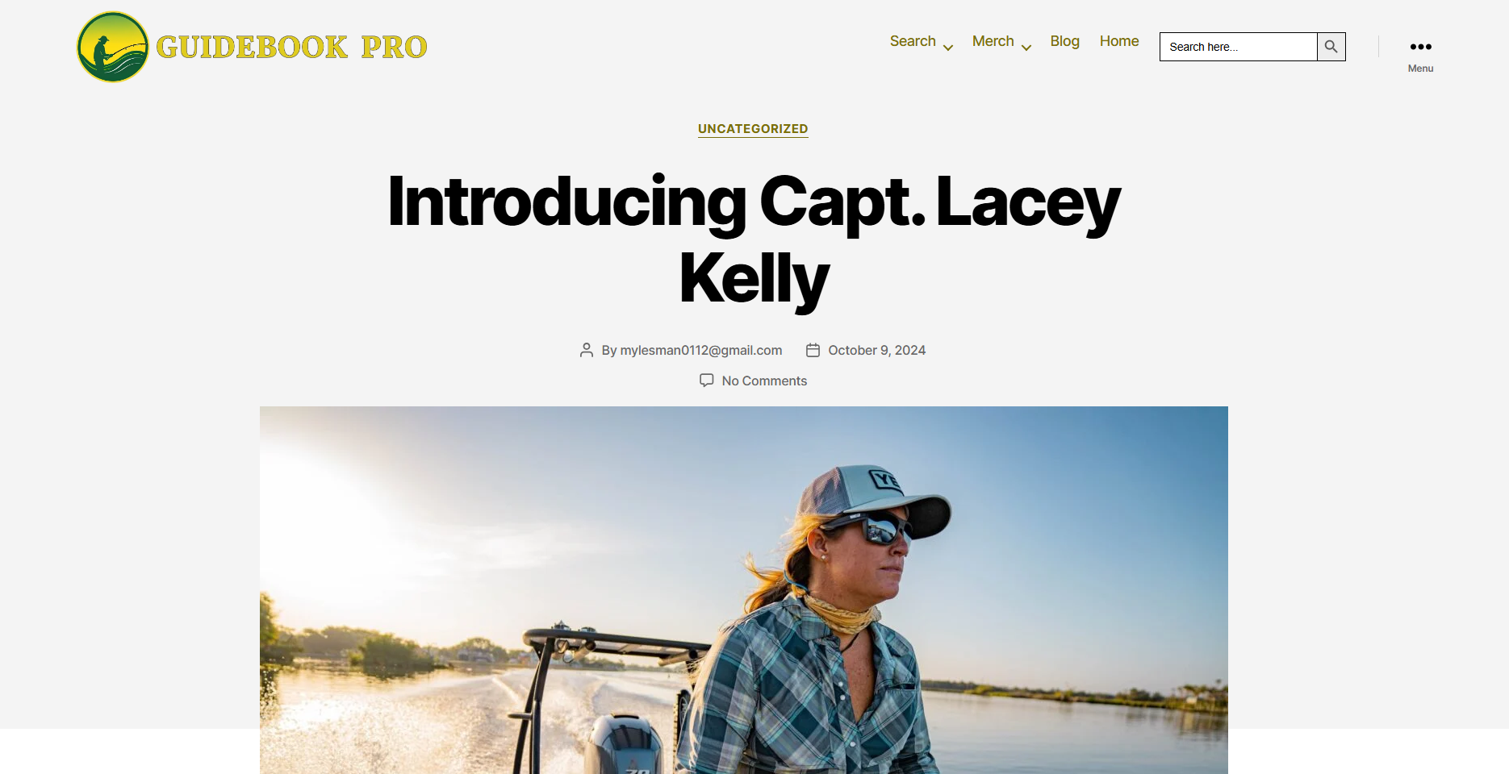
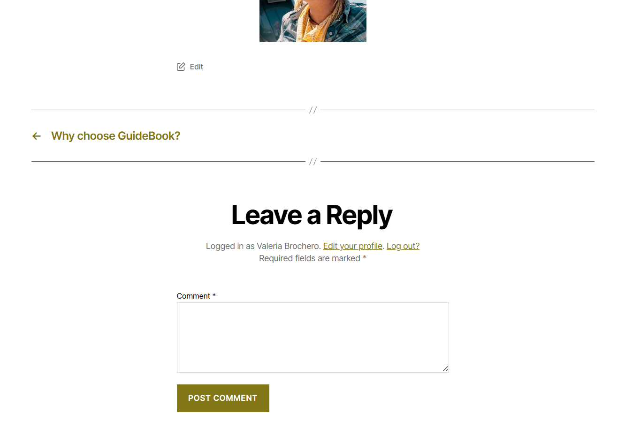
Blog Post Page
This is the format that all blog posts will be in, with the ability to scroll through them and to leave a public comment.

Slide 17
Thank You!
Jackson Mundy, Daniel Willlinger, Alexander Mclver, Tanner Schultz, Jackson Hallahan, & Valeria Brochero

